Slide 1
Entrustable Professional Activity (EPA)

Slide 2
Acknowledgement to Country
We acknowledge this land that we work on today is the traditional lands for the Kaurna people and that we respect their spiritual relationship with their country. We also acknowledge the Kaurna people as the custodians of the greater Adelaide region and that their cultural and heritage beliefs are still important to the living Kaurna people today. We also pay respects to the traditional lands others are joining from today.

Slide 3
National Framework for Prevocational (PGY1 & PGY2) Medical Training
Notes:
In 2015, the AMC conducted a review of that National Framework for Internship and in 2020, the review of internship scope was expanded to develop a 2 year Prevocational Capability and Performance Framework.
As a result, the Framework has been expanded to include PGY2.
There are three components of the National Framework:
Training and Assessment, Training Environment and Quality Assurance.
Training and Assessment describes how doctors are trained and assessed in the first two years after medical school, and set standards that contribute to good quality training. This includes the assessment of Entrustable Professional Activities (EPAs).

Slide 4
National Framework for Prevocational (PGY1 & PGY2) Medical Training
Notes:
The Training and Assessment component consists of outcome statements, EPAs and term assessments.
Once the intern completes the first year of training an Assessment Review Panel will recommend to Ahpra general registration of interns. PGY2s will receive a certificate of completion.
The plan is to have a National ePortfolio in 2025 which will support the record of training assessments.

Slide 5
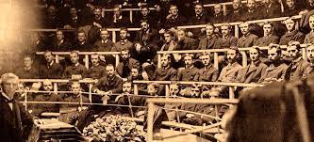
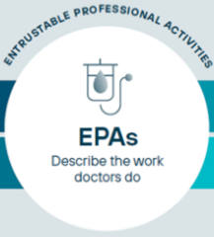
History of EPAs?
Competency-based medical education was embraced in several countries in the 1990s
move from time-based to competency- based medical education
Entrustable Professional Activities
Move to connect competencies better to the practice of every-day work in health care.
In 19th centuries, most western countries began to regulate the medical profession on a national level, assuming responsibilities for the health of the population and to protect citizens against incompetent medical practitioners
Notes:
In the 19th centuries, most Western countries thought about regulating the medical profession.
Competency based medical practice commenced in several countries in the 1990’s.
We moved from a time based model to a competency-based model of medical education.
EPAs have arisen out of a move to connect to a competency based framework where we have listed what competencies we want doctors to achieve in medicine and linked them to the practice of everyday work in healthcare.

Slide 6
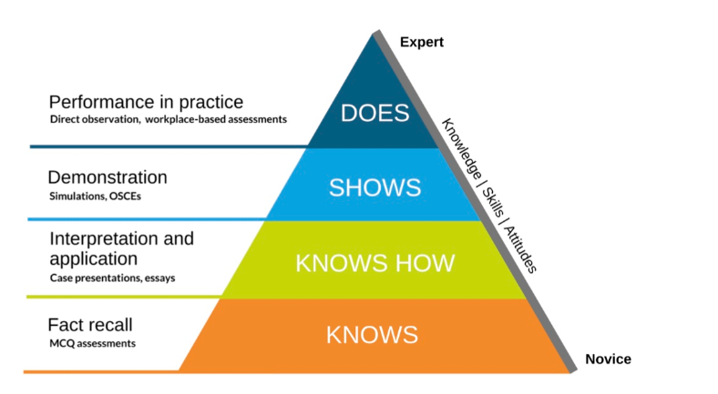
Miller’s Pyramid
EPA
Notes:
In 1990 George Miller outlined a new model for the assessment of clinical competency.
Miller argued that the traditional assessment of medical students relied too much on testing their knowledge, and not enough on assessing how they would behave in a real-life consultation. His model, known as the ‘Miller pyramid’, was the basis for an important move away from the traditional medical education model that was dominated by theoretical knowledge-based assessments, towards examinations based on clinical performance.
Miller’s pyramid is a way of ranking clinical competence both in educational settings and in the workplace.
Miller’s pyramid is usually described as having 4 levels; knows, knows how, shows how and does.
Knows – is a way of testing knowledge, e.g. with MCQ assessments.
Knows how – can be tested through case presentations, essays and demonstrations.
Shows – can be done through Simulations and OSCEs.
Does – is where EPAs are assessed with performance in practice.

Slide 7
What is an EPA?
Entrustable
Professional
Activity
Notes:
What is an EPA?
Entrustable Professional Activity

Slide 8
What is an EPA?
Describe the essential work that doctors do
The responsibilities or tasks that must be done in patient care
These tasks can be small or large
Notes:
EPAs are a description of essential work tasks that prevocational doctors undertake as part of providing health care.
They are the responsibilities or tasks that must be done in patient care and they can be large tasks or small tasks.

Slide 9
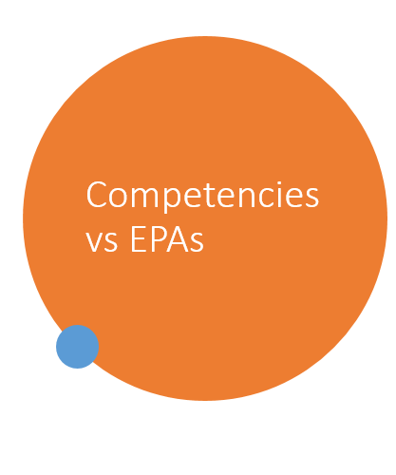
Competencies vs EPAs
Competencies describe persons. Learners who become competent professionals must acquire competencies that include knowledge, skills, and attitudes. Professionals can possess competencies; they can never possess EPAs
Olle ten Cate 2018
Notes:
An EPA is essentially an activity and encompasses multiple competencies.
Competencies describe the person or the attributes of the person, the knowledge, skills and attitudes.
Professionals possess competencies but they can't possess an EPA. This is the idea that the EPA is an expression of your work.

Slide 10
What should an EPA look like?
Core business- high importance for everyday work
High risk or error prone
Exemplar of domain/s- e.g. communication, scholar, leader, medical expert*
Notes:
An EPA should look at the AMC framework and the tasks that are undertaken in every day work.
The EPA should also look at high risks or error prone tasks in some settings.
The EPA is very helpful in looking at a framework and ensuring they tick off multiple domains. This includes the AMC domains.

Slide 11
AMC Prevocational Framework EPAs
Notes:
The AMC’s four EPAs are key to everyday work practice.
EPA 1 Clinical assessment: work that an intern might be expected to do perhaps on a short call or an admission, incorporating history, examination, and formulation of a differential diagnosis and a management plan.
EPA 2 Recognition care of the acutely unwell patient: anything for working acutely or the need to recognise the deterioration in a patient.
EPA 3 Prescribing: includes prescribing not only medications but fluids, blood products, inhalational therapies, including oxygen.
EPA 4: is around communication and documentation.

Slide 12
AMC Prevocational Framework EPAs
Notes:
The AMC will use the four domains or prevocational outcome statements:
Scientist and scholar
Practitioner
Advocate
Professional and leader
Outcome statements describe the broad and significant capabilities that prevocational doctors should achieve by the end of their PGY1 and PGY2 years.
Prevocational doctors can cover nearly all of the AMC Prevocational Outcome Statements through assessment of the EPAs.
The four EPAs are anchored to the prevocational outcome statements in the same domains and assist in achieving the outcome statements.

Slide 13
Example of EPAs
Example 1: An RMO or registrar on a clinical ward is called by a nurse in the night must be able to evaluate a deteriorating patient and take action to stabilize the patient’s condition. This could typically be an EPA for residency in intensive care.
Example 2: A junior RMO in obstetrics may be entrusted with the care for a delivery if there are no signs that point at complications.
Example 3: A senior medical student may be asked to examine an evaluate a patient with a known chronic condition, order diagnostic test if needed, prepare follow-up medication and do all the work that only needs to be completed and signed by a clinical staff member.
Notes:
The first example – an RMO or registrar on a clinical ward is called by a nurse during the night must be able to evaluate its deteriorating patient and take action to stabilise a patient's condition. This could be an EPA for someone working in intensive care as an RMO or registrar.
Can they evaluate the deteriorating patient and take the action necessary to stabilise the patient?
The next example – an activity of a junior RMO in obstetrics. They might be entrusted with the care of a delivery if there were no signs of complications being imminent for that delivery.
The third example – a senior medical student may be asked to examine or evaluate a patient with a known chronic condition, order the diagnostic testing needed and prepare the follow up medication and do all the work that only needs to be completed and then signed by a clinician.
A prevocational doctor might undertake the whole admission for someone who comes in with an acute exacerbation, take the patient through all the steps of history examination assessment, order the test and determine what the initial treatment should be.

Slide 14
The Entrustment Levels
Requires direct supervision
Requires proximal supervision
Requires minimal supervision
Notes:
The entrustment levels within the AMC framework will be rated as either requires minimal supervision, proximal supervision or direct supervision.
Requires direct supervision - the term supervisor or clinical supervisor need to be there to observe the interactions and review the work.
Requires proximal supervision - the term supervisor or clinical supervisor need to be easily contacted, and able to provide immediate or detailed review of work.
Requires minimal supervision - the prevocational doctor is trusted to complete the task and supervisors need to be contactable/ in the building and able to provide general overview of work.

Slide 15
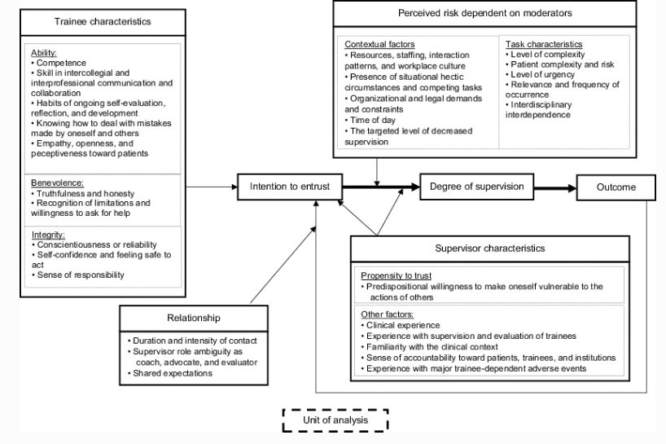
How are Entrustment Decisions Made
Decision-making about trainees in health care: a conceptual model- Holzhausen et al 2017
Notes:
An EPA assessment is an assessment whether you would trust a doctor to do a specific activity and how far would you trust them?
This is a model about how an entrustment decision is made.
There are multiple characteristics that are involved in entrustment decisions.
Including trainee characteristics, supervisor characteristics, perceived risk dependent on context and the task and relationships.
There are some supervisors that move quickly to entrustment and there are others that find it very hard to be comfortable with a character judgment of the person they're working with.

Slide 16
AMC Assessment of EPAs
Notes:
EPAs are expected to be completed during the routine work of the prevocational doctor with supervisors making a judgement about how safely a TMO can perform their work, and their level of entrustability.
The supervisor’s assessment is not a pass or fail. It is a judgement of the prevocational doctor’s degree of entrustability for the work being observed.
If an intern does not complete an EPA in their first term to an expected level, that doesn't mean that they’re not learning and collecting valuable skills on the way.
At least one EPA assessment per term should be completed by the term supervisor; others can be completed by other clinical supervisors, the registrar, other health professionals.
EPAs will be able to be assessed by specialists or equivalent and some will be able to be assessed by registrars, nurses, pharmacists and others as appropriate.
The number of EPA assessments is a minimum of 10 across each year with this achieved by completion of 2 or 3 each term.
EPA 1 will be assessed at least once in each term and EPAs 2-4 will be assessed at least twice throughout the year.
An EPA assessment should be able to be completed in 10 minutes or less.

Slide 17
AMC Assessment of EPAs
Notes:
Example of assessment within a term commencing with a beginning of term discussion followed by an assessment on EPA 3, midterm assessment, further EPA assessments and finally an end of term assessment.

Slide 18
Video Introducing EPAs

Slide 19
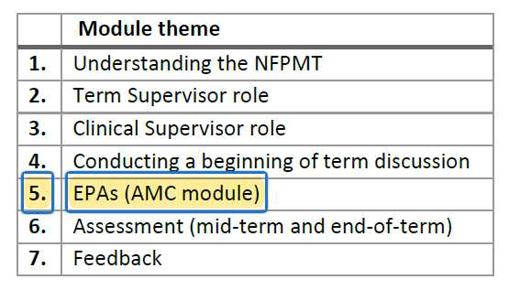
Training Modules
Notes:
The AMC have endorsed the PMCV as the organisation to lead the development of supervisor training and modules which will be made available for prevocational doctors, clinical supervisor (such as registrars), term supervisors, DCTs, MEOs and the Assessment Review Panel.
There will be an EPA module and these modules will be available nationally by 30 September 2023.

Slide 20
QUESTIONS?

Slide 21
Thank you for joining us
today!

